Slide 1
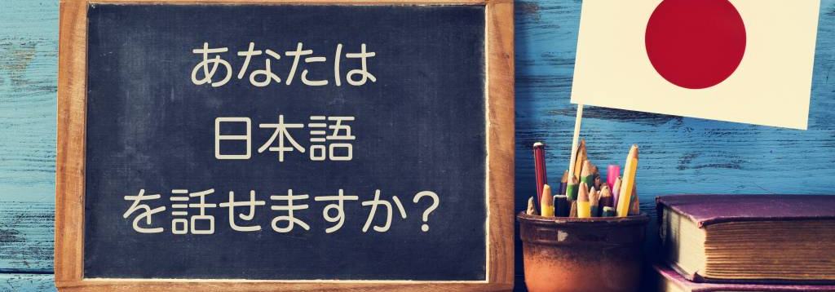
Japanese Pitch Accent Trainer
Hafza Abdullahi, Final Year Project

Slide 2


The problem
20XX
English uses a Stress Accent Force, length, and clarity on one syllable. And its very obvious
Example: PRE sent (Verb) vs. preSENT(noun)
Most Japanese Learners can't hear pitch accents, especially as an English speaker

Slide 3

Pitch accents
20XX
Japanese uses a Pitch Accent: A musical, high-low pattern
Low -> High
Low -> high - > low
High -> Low
Low -> high -> + ending particle low

Slide 4

Pitch accent example
20XX
Japanese uses a Pitch Accent: A musical, high-low pattern on vowels.
Example: iru (to be) = Low – high
Example: iru (to need) = High - Low

Slide 5
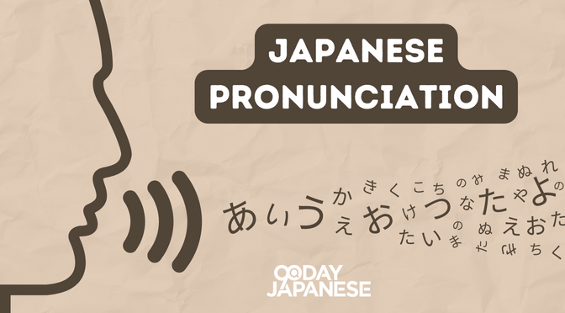
What will this app do?
20XX
Goal: improve pronunciation
Instant visual feedback
Corrections using native speaker comparisons
Long term learning using spaced repetition

Slide 6
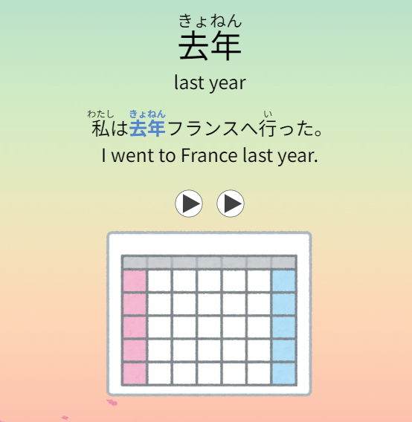
Use of the app
20XX
User is shown a word and its pitch accent
User records their attempt at pronunciation

Slide 7
Use of the app
20XX
Recording is analysed using pythons parselmouth pratt library to detect pitch changes and visualize them
User can then rate their answer on a scale of good to bad
Next time that word is shown depends on spaced repetition

Slide 8
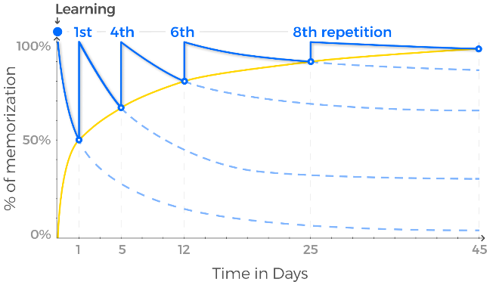
The forgetting curve
20XX
Based on Hermann Ebbinghaus's 1885 research on memory.
The "Forgetting Curve" shows our memory for new information fades rapidly without review.
The Solution: Spaced repetition fights this by scheduling reviews just before you are about to forget.

Slide 9
Spaced Repetition
20XX
Core Concept: Information is better remembered when studying is spread out over time, instead of crammed.
Proven Tool: Digital flashcards (like Anki) effectively automate this technique.

Slide 10
Why It Works for Language Learning
20XX
Strengthens Memory Builds Long-Term Retention Efficiency

Slide 11
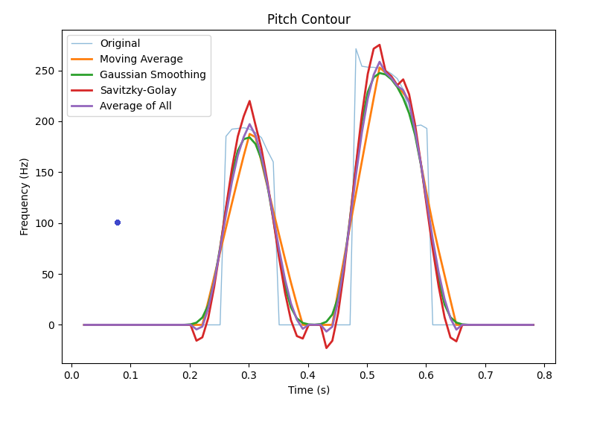
Speech Analysis
Visualizing Speech and extracting Pitch
What is Pythons parlsemouth praat?
Powerful speech analysis tool
to_pitch() function
Pitch detection
Automatically extract the fundamental frequency (pitch)

Slide 12
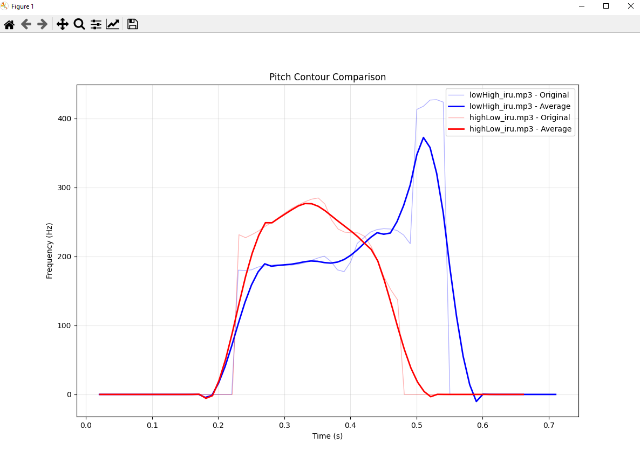
Word: “iru”, and its two pitch patterns same speaker
20XX

Slide 13
Speech Analysis
Visualizing Speech and extracting Pitch
Smoothing
smooth artefacts and vocal jitter
See clear changes in pitch
Easier to compare

Slide 14
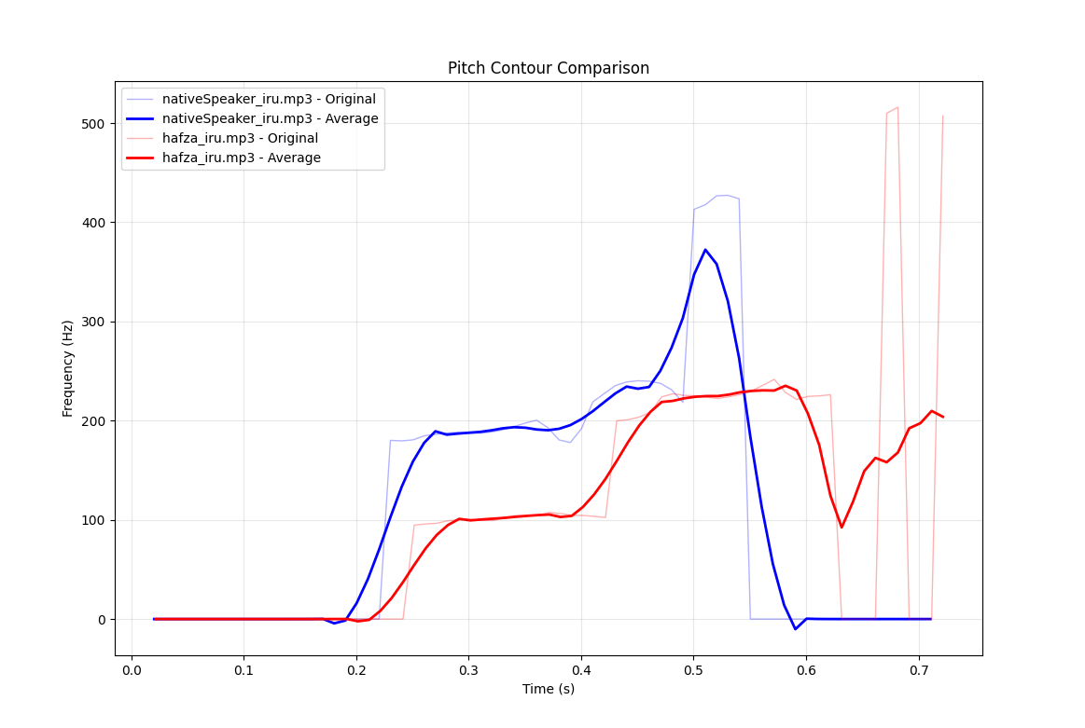
Speech comparison: word iru, low - high
Visualizing Speech and extracting Pitch
The Problem
same word
Different speakers
Different graphs
Direct Point to point comparison is useless
Solution?

Slide 15
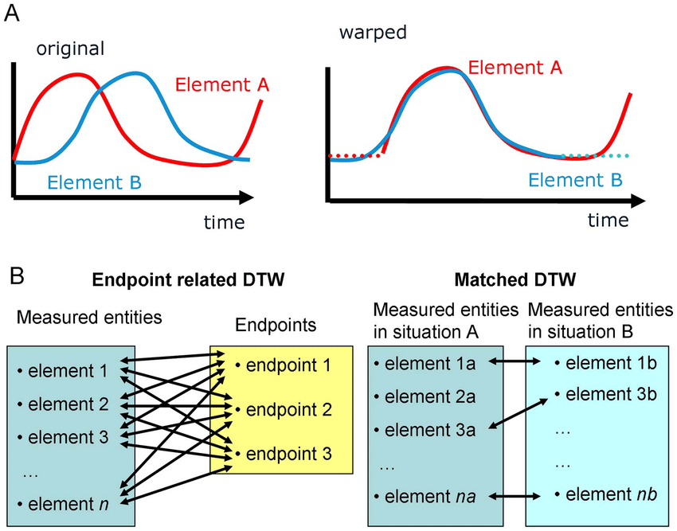
Dynamic Time warping
Visualizing Speech and extracting Pitch
Solution
Elastic algorithm
warps the time axis of two sequences to find the optimal match between them
It doesn't change the data
stretching and compressing the graphs locally

Slide 16
Dynamic Time warping
Visualizing Speech and extracting Pitch
Solution
Elastic algorithm
warps the time axis of two sequences to find the optimal match between them
It doesn't change the data
stretching and compressing the graphs locally
Get the "Warping Path“ The algorithm outputs a path that shows how each point in my speech corresponds to a point in the native speaker’s.

Slide 17
Dynamic Time warping
Visualizing Speech and extracting Pitch
Analyze the Differences
Timing: The warping path itself shows where I was slower or faster.
Accuracy: measure the difference in pitch and intensity at each corresponding point. This gives a true measure of pitch accuracy

Slide 18
Next Iteration?
Displaying Japanese words with meaning, pitch accent using a dictionary library backed by firebase
A way for user to record their audio
Convert python script to flask to use with app
Use Dynamic Time warping to give accuracy results

Slide 19
Thanks for listening
Any Questions?

Slide 20
References
Into to Japanese Pitch Accent https://www.lucalampariello.com/japanese-pitch-accent/
Intro to Parselmouth praat : https://www.sciencedirect.com/science/article/abs/pii/S0095447017301389
Japanese Pitch Accents video: https://www.youtube.com/watch?v=aOxRYmWDaF4
Dynamic Time warming, https://link.springer.com/chapter/10.1007/978-3-540-74048-3_4
Pitch accent dictionary, https://www.gavo.t.u-tokyo.ac.jp/ojad/search
The forgetting curve: Hermann Ebbinghaus, 1885 https://www.taalhammer.com/the-forgetting-curve-hermann-ebbinghaus/
Kanshudo Pitch accent site https://www.kanshudo.com/howto/pitch accessed 18/10/2025

